Slide 1
Randomized Algorithms CS648A
Lecture 3
Frievald’s Technique – Final Analysis
Probability Amplification
2 Interesting Problems on probability

Slide 2
Elementary Probability theory
The slides for this topic posted on the course website just after 1st lecture.
Please go through these slides, if not already done.

Slide 3
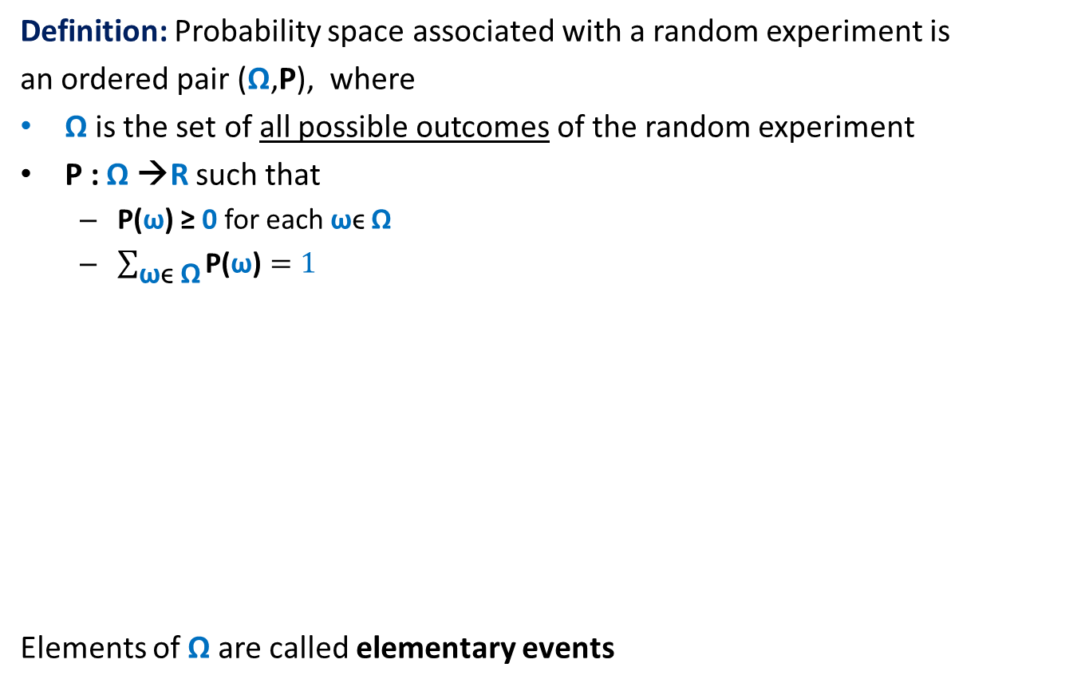
Probability Space
Definition: Probability space associated with a random experiment is
an ordered pair (Ω,P), where
Ω is the set of all possible outcomes of the random experiment
P : Ω →R such that
P(ω) ≥ 0 for each ωϵ Ω
$\sum_{\text{ω}\text{ϵ} \text{Ω}}{\text{P}\text{(}\text{ω}\text{)}}=1$
Elements of Ω are called elementary events
Ω
or sample points.

Slide 4


Event in a Probability Space
Definition: An event A in a probability space (Ω,P) is a subset of Ω.
The probability of event A is defined as
$$\sum_{\text{ω}\text{ϵ} \text{A}}{\text{P}\text{(}\text{ω}\text{)}}$$
For sake of compact notation, we extend P for events as described above.
$\text{P}\text{(}\text{A}\text{)}$ =
A
Ω

Slide 5
Elementary Concepts
Probability of
Union of events
Intersection of events
Conditional Probability
Independent events
Disjoint events

Slide 6



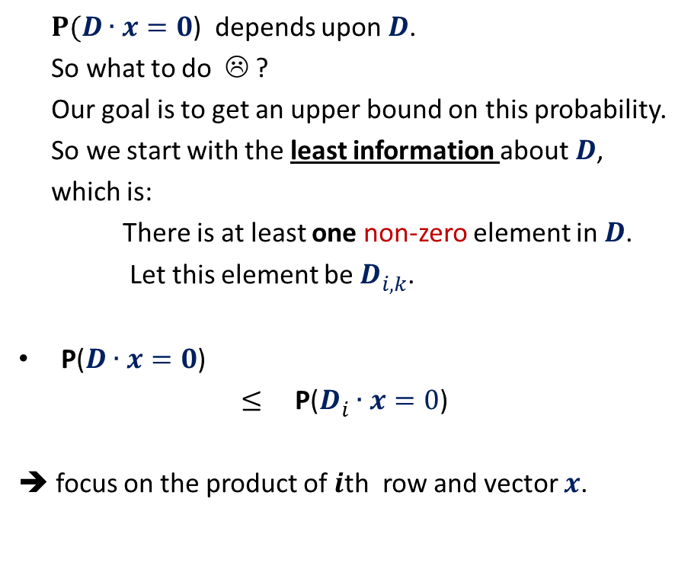


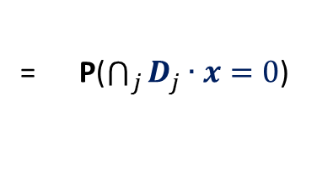


Frievald’s Algorithm (Analyzing error probability)
?
$$k$$
$P(D∙x=0$) depends upon $D$.
So what to do ☹ ?
Our goal is to get an upper bound on this probability.
So we start with the least information about $D$,
which is:
There is at least one non-zero element in $D$.
Let this element be $D_{i,k}^{}$.
P($D∙x=0$)
$≤$ P($D_{i}^{}∙x=0$)
➔ focus on the product of $i$th row and vector $x$.
$$1 2 … n$$
$$1$$
2
$$⋮$$
$$n$$
$$⨯$$
$$i$$
= P($\bigcap_{j}{D_{j}^{}∙x=0}$)
$$D$$
$$x$$
What is the relation between the two ?
Non null matrix

Slide 7


Frievald’s Algorithm (Analyzing error probability)
$$k$$
P($D_{i}^{}∙x=0$) = P($D_{i1}^{}$ $∙x_{1}$ + … + $D_{in}^{}$ $∙x_{n}$ = 0)
The underlying sample space has $2^{n}$ elementary events.
Convince yourself that it is indeed difficult to calculate this probability from standard tools which you know.
Here we shall use a simple but powerful probability tool…
$$1 2 … n$$
$$1$$
2
$$⋮$$
$$n$$
$$⨯$$
$$i$$
$$D$$
$$x$$

Slide 8









Probability tool: Partition of sample space
A set of events $A_{1}$,…, $A_{n}$defined over a probability space ($Ω$,P)
is said to induce a partition of $Ω$ if
$\bigcup_{l=1}^{n}{A_{l}}$ = $Ω$
$A_{i}\bigcap{A_{j}}$ =∅ for all$i≠j$
Theorem: (Partition theorem)
Given an event $ε$, we can express P($ε$) in terms of a given partition as:
P($ε$) = $\sum_{l}{\text{P}\text{(}ε}∩A_{l}$)
= $\sum_{l}{\text{P}\text{(}ε}\text{|}A_{l}$)∙ $\text{P}\text{(}A_{l}\text{)}$ using conditional probability
$≤$ $α$ $\sum_{l}{\text{P}\text{(}A_{l}\text{)}}$
$=$ $α⋅1$
$$A_{2}$$
$$A_{3}$$
$$A_{4}$$
$$ε$$
$$A_{5}$$
$$A_{1}$$
Ω
$$A_{6}$$
$$≤α$$

Slide 9

Probability tool: Partition of sample space
A set of events $A_{1}$,…, $A_{n}$defined over a probability space ($Ω$,P)
is said to induce a partition of $Ω$ if
$\bigcup_{l=1}^{n}{A_{l}}$ = $Ω$
$A_{i}\bigcap{A_{j}}$ =∅ for all$i≠j$
Theorem: (Partition theorem)
Given an event $ε$, we can express P($ε$) in terms of a given partition as:
P($ε$) = $\sum_{l}{\text{P}\text{(}ε}∩A_{l}$)
= $\sum_{l}{\text{P}\text{(}ε}\text{|}A_{l}$)∙ $\text{P}\text{(}A_{l}\text{)}$ using conditional probability
$$A_{2}$$
$$A_{3}$$
$$A_{4}$$
$$ε$$
$$A_{5}$$
$$A_{1}$$
Ω
$$A_{6}$$

Slide 10
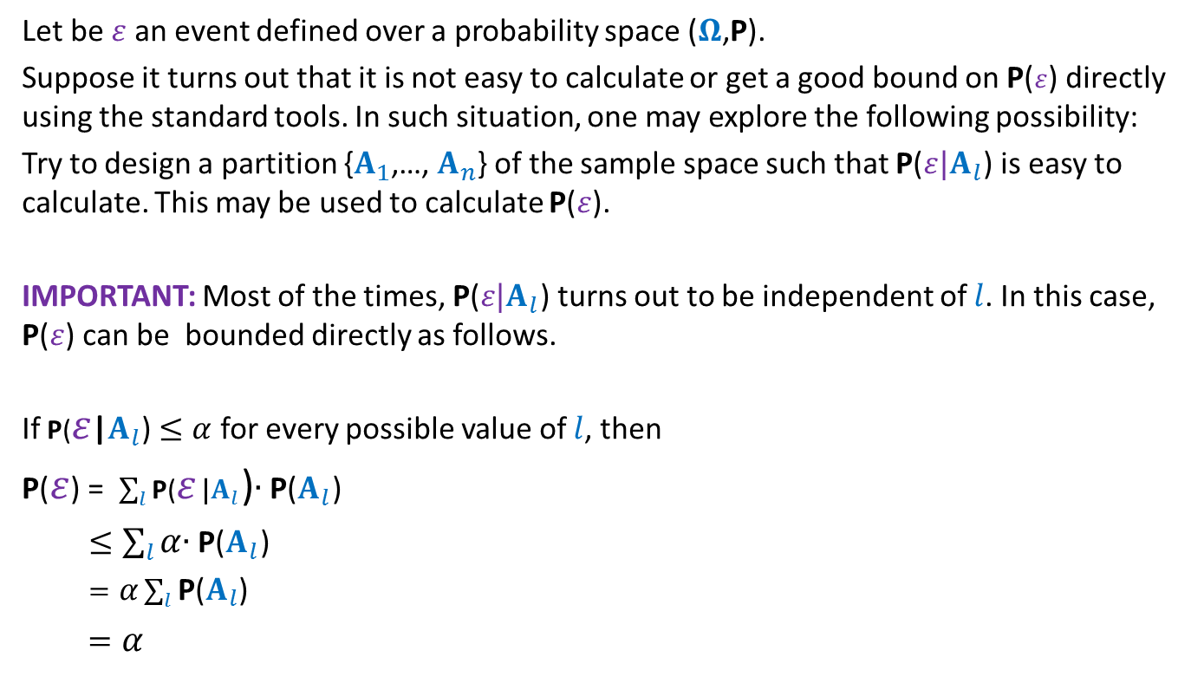
Question: When to use the Partition theorem ?
Let be $ε$an event defined over a probability space ($Ω$,P).
Suppose it turns out that it is not easy to calculate or get a good bound on P($ε$) directly using the standard tools. In such situation, one may explore the following possibility:
Try to design a partition {$A_{1}$,…, $A_{n}$} of the sample space such that $\text{P}\text{(}ε|A_{l}$) is easy to calculate. This may be used to calculate $\text{P}\text{(}ε$).
IMPORTANT: Most of the times, $\text{P}\text{(}ε|A_{l}$) turns out to be independent of $l$. In this case, $\text{P}\text{(}ε$) can be bounded directly as follows.
If $\text{P}\text{(}ε$|$A_{l}$) $≤α$ for every possible value of $l$, then
P($ε$) = $\sum_{l}{\text{P}\text{(}ε}\text{|}A_{l}$)∙ $\text{P}\text{(}A_{l}\text{)}$
$≤\sum_{l}{α}$∙ $\text{P}\text{(}A_{l}\text{)}$
$=α\sum_{l}{\text{P}\text{(}A_{l}\text{) }}$
$=α$

Slide 11


Frievald’s Algorithm (Analyzing error probability)
$$ε$$
P( $D_{i1}^{}$ $∙x_{1}$ + … + $D_{in}^{}$ $∙x_{n}$ = 0 ) = ??
Question:
What can be the suitable partition of $Ω$?
➔ the partition defined by the values taken by all the r.v.’s excluding $x_{k}$.
…

Slide 12










Frievald’s Algorithm (Analyzing error probability)
$$ε$$
P( $D_{i1}^{}$ $∙x_{1}$ + … + $D_{in}^{}$ $∙x_{n}$ = 0 ) = ??
Question: What is the probability of $ε$conditioned on
any arbitrary but fixed values taken by all $x_{j}, j≠k$ ?
Answer: Consider any $n−1$ values $a_{1}, \text{…,} { a}_{k−1}, a_{k+1}, …,a_{n} ϵ \left\{0,1\right\}.$
$\text{P}\text{(}ℰ | x_{1}=a_{1}, \text{…}\text{,}x_{k−1}=a_{k−1},x_{k+1}=a_{k+1}, …,{x_{n}=a}_{n}$)
$=$ ?
$$=\text{P}\text{(}D_{i,k}^{}∙x_{k}=−(D_{i,1}^{} ∙a_{1}+\text{…}+D_{i,k−1}^{}∙a_{k−1}\text{+ }D_{i,k+1}^{}∙a_{k+1}{+ …D}_{in}^{}∙a_{n}\text{)}\text{)}$$
$=\text{P}\text{(}x_{k}=−(D_{i,1}^{} ∙a_{1}+\text{…}+D_{i,k−1}^{}∙a_{k−1}\text{+ }D_{i,k+1}^{}∙a_{k+1}{+ …D}_{in}^{} ∙a_{n}\text{)/}D_{i,k}^{}$)
$$≤½$$
$≤½$
$$= \text{P}\text{(}D_{i,1}^{} ∙ x_{1} +\text{…}+D_{i,k−1}^{}∙ x_{k−1} \text{+ }D_{i,k}^{}∙ x_{k} +D_{i,k+1}^{}∙{ x}_{k+1} {+ …D}_{in}^{}∙ x_{n} \text{ = 0}$$
$$\text{|}$$
$$x_{1}=a_{1}, \text{…} \text{,}x_{k−1}=a_{k−1},{ x}_{k+1}=a_{k+1}, …, {x_{n}=a}_{n} \text{)}$$
$$a_{1}$$
$$a_{k−1}$$
$$a_{k+1}$$
$$a_{n}$$
$$\text{)}$$
≠0
Since the value of all $x_{i},i≠k$have been determined due to conditioning, we can plug them in.
Since $x_{k}$ is independent of $x_{1},…x_{k−1},x_{k+1},…x_{n}$
Could be 0, 1 or some other number

Slide 13

Frievald’s Algorithm (Analyzing error probability)
Theorem:
Error probability of algorithm RandomProductVerify($A$,$B$,$C$) is at most $½$.
Question: How to increase the success probability ?

Slide 14
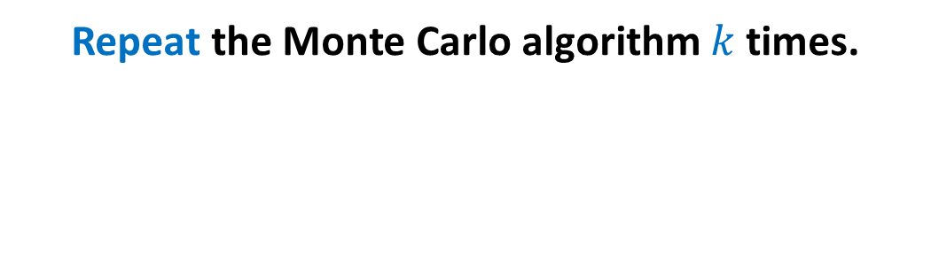
Probability Ampilification
Repeat the Monte Carlo algorithm $k$ times.

Slide 15
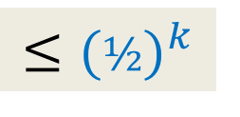
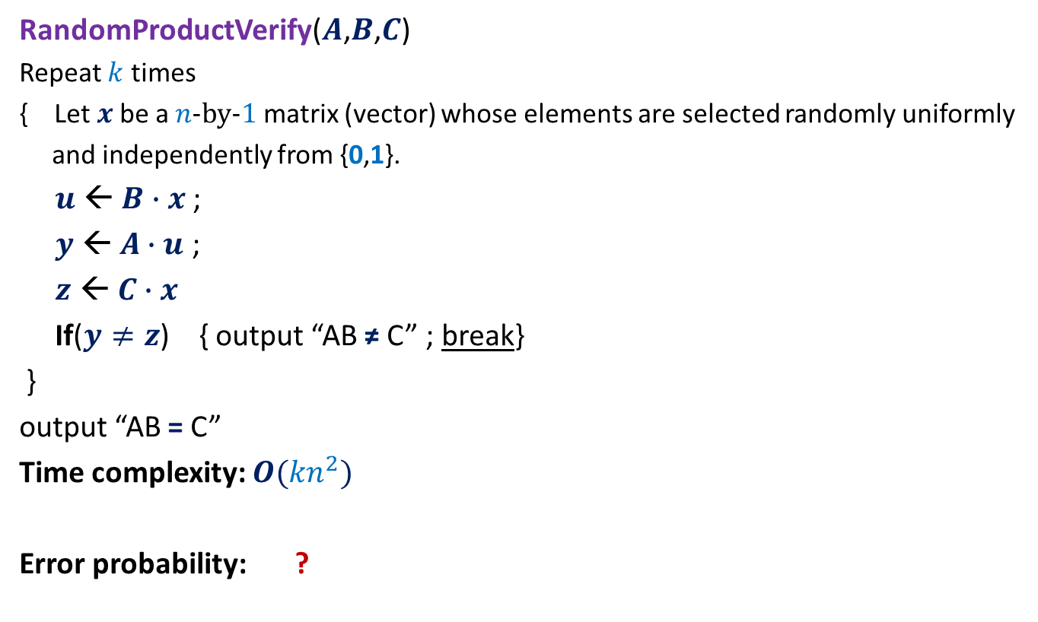
Frievald’s Algorithm (reducing the error probability)
RandomProductVerify($A$,$B$,$C$)
Repeat $k$ times
{ Let $x$be a $n$-by-$1$matrix (vector) whose elements are selected randomly uniformly
and independently from {0,1}.
$u$ ← $B∙x$ ;
$y$ ← $A∙u$ ;
$z$ ← $C∙x$
If($y≠z$) { output “AB ≠ C” ; break}
}
output “AB = C”
Time complexity: $O({kn}^{2})$
Error probability: ?
$$≤{(½)}^{k}$$

Slide 16

Frievald’s Algorithm (final result)
Theorem: Given three $n$-by-$n$matrices $A$, $B$, and $C$,
there is a Randomized Monte Carlo algorithm which determines $C≟A⨯B$.
The running time is $O(n^{2}log n)$, and the error probability is less than $n^{−2}$.

Slide 17
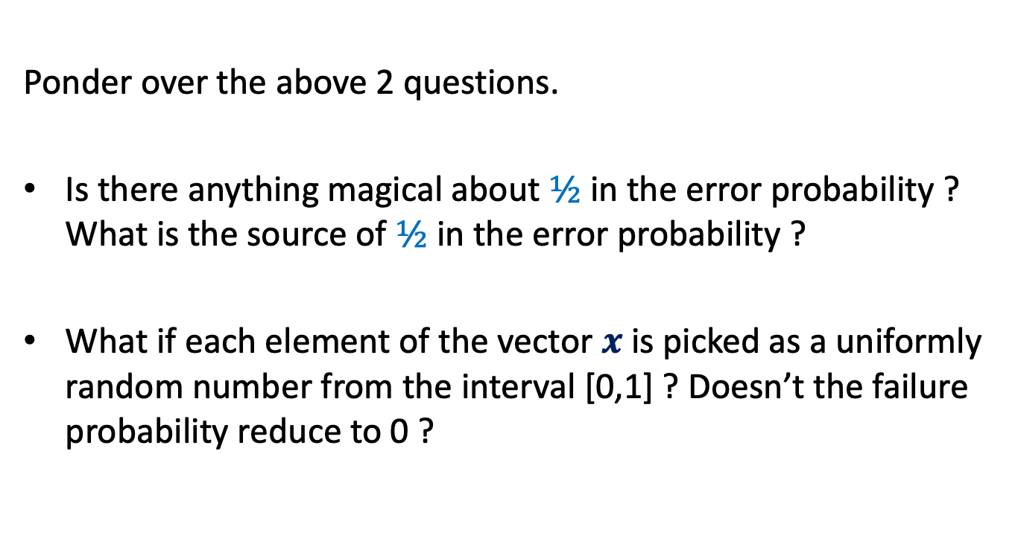
Homework
Ponder over the above 2 questions.
Is there anything magical about $½$ in the error probability ? What is the source of $½$ in the error probability ?
What if each element of the vector $x$ is picked as a uniformly random number from the interval [0,1] ? Doesn’t the failure probability reduce to 0 ?

Slide 18
Balls into BINS
Problem 1

Slide 19
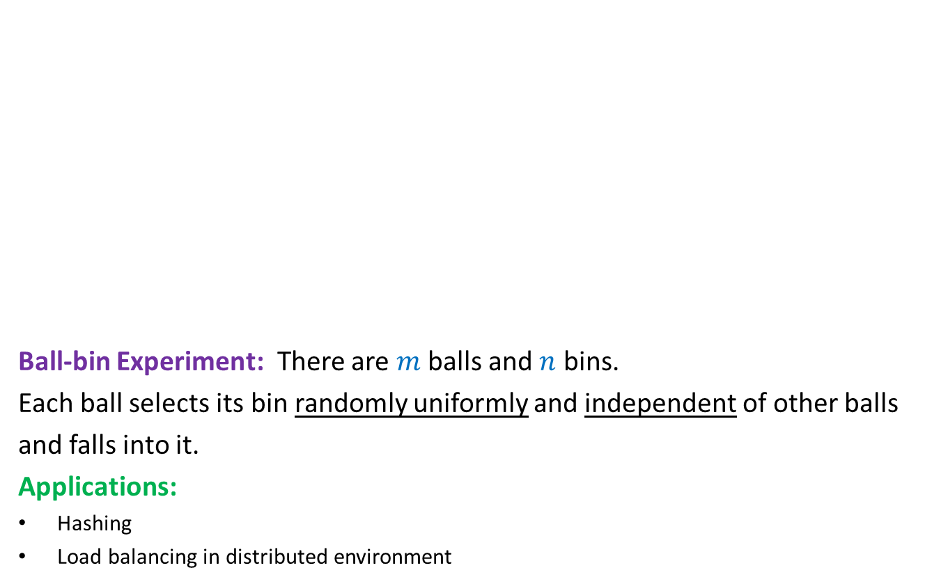
Balls into Bins
1 2 3 4 5 … $m−1$ $m$
Ball-bin Experiment: There are $m$ balls and $n$ bins.
Each ball selects its bin randomly uniformly and independent of other balls
and falls into it.
Applications:
Hashing
Load balancing in distributed environment
1 2 3 … $i$ … $n$

Slide 20
Balls into Bins
1 2 3 4 5 … $m−1 m$
Question : What is the probability that there is at least one empty bin ?
1 2 3 … $i$ … $n$

Slide 21
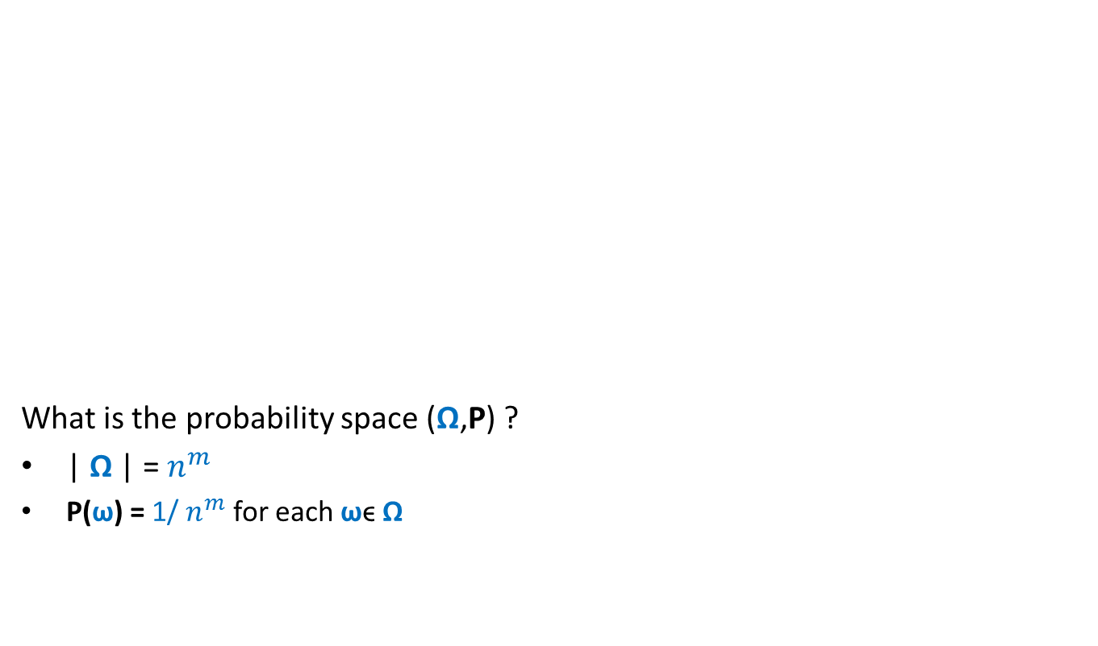
Balls into Bins
1 2 3 4 5 … $m−1 m$
What is the probability space (Ω,P) ?
| Ω | = $n^{m}$
P(ω) = 1/ $n^{m}$ for each ωϵ Ω
1 2 3 … $i$ … $n$

Slide 22
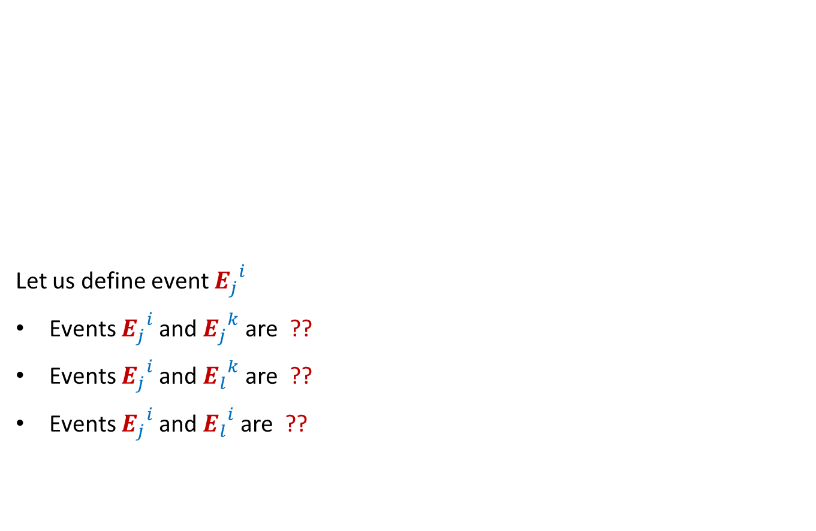

Balls into Bins
1 2 3 4 5 … $j$ … $m−1 m$
Let us define event ${E_{j}}_{}^{i}$
Events ${E_{j}}_{}^{i}$and ${E_{j}}_{}^{k}$are ??
Events ${E_{j}}_{}^{i}$and ${E_{l}}_{}^{k}$are ??
Events ${E_{j}}_{}^{i}$and ${E_{l}}_{}^{i}$are ??
1 2 3 … $i$ … $n$
: $j$th ball falls into $i$th bin.
disjoint
Independent
Independent

Slide 23


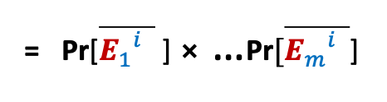
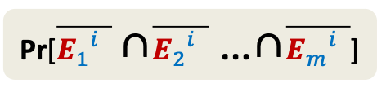

Balls into Bins
1 2 3 4 5 … $j$ … $m−1 m$
${E_{j}}_{}^{i}$ : $j$th ball enters $i$th bin.
Pr[${E_{j}}_{}^{i}$] = ??
Pr[$\overline{{E_{j}}_{}^{i}}$] = ??
Pr[$i$th bin is empty] = ??
=${(1−\frac{1}{n} )}^{m}$
1 2 3 … $i$ … $n$
$$\frac{1}{n}$$
$$1−\frac{1}{n}$$
Pr[$\overline{{E_{1}}_{}^{i}}$ ∩$\overline{{E_{2}}_{}^{i}}$ …∩$\overline{{E_{m}}_{}^{i}}$]
= Pr[$\overline{{E_{1}}_{}^{i}}$ ] ⨯ …$\text{Pr}[\overline{{E_{m}}_{}^{i}}$]

Slide 24



Balls into Bins
1 2 3 4 5 … $j$ … $m−1 m$
Pr[$i$th bin is empty] = ${(1−\frac{1}{n} )}^{m}$
Pr[$i$th and $k$th bin are empty] = ??
Pr[a specified set of $l$bins are empty] = ??
1 2 3 … $i$ … $n$
$${(1−\frac{2}{n} )}^{m}$$
$${(1−\frac{l}{n} )}^{m}$$

Slide 25
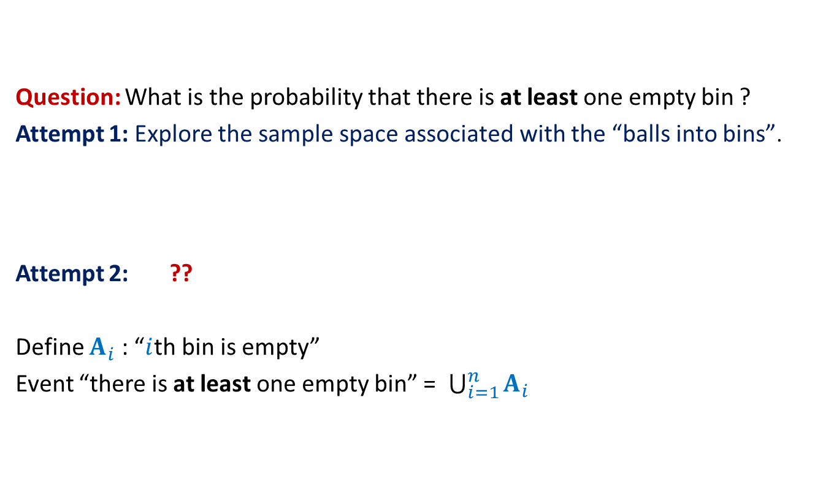
Balls into Bins
Question: What is the probability that there is at least one empty bin ?
Attempt 1: Explore the sample space associated with the “balls into bins”.
Attempt 2: ??
Define $A_{i}$ : “$i$th bin is empty”
Event “there is at least one empty bin” = $\bigcup_{i=1}^{n}{A_{i}}$
Express the event as union of some events …

Slide 26

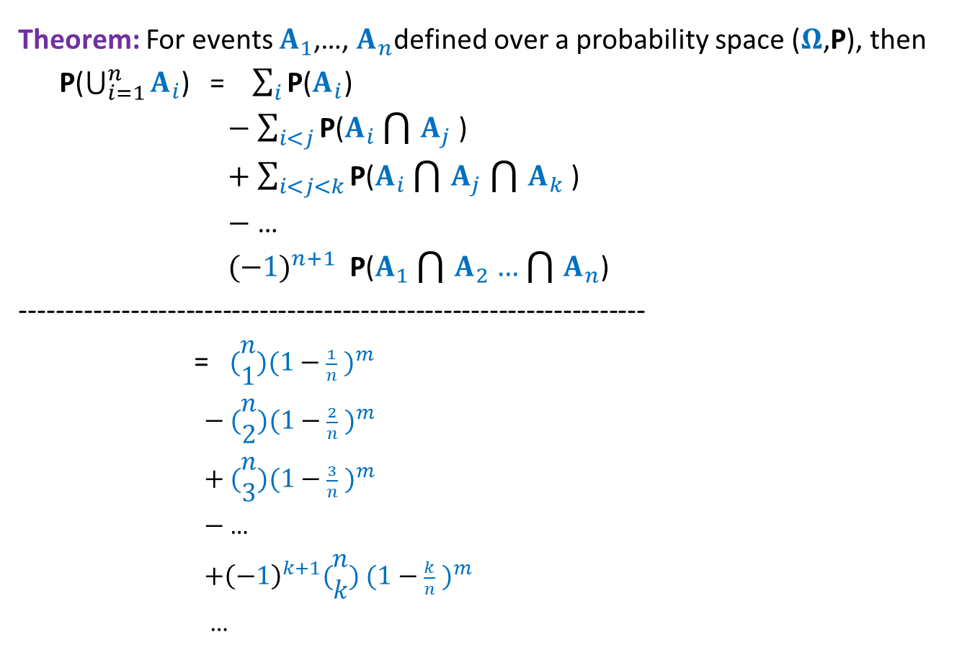
Balls into Bins
Theorem: For events $A_{1}$,…, $A_{n}$defined over a probability space ($Ω$,P), then
P($\bigcup_{i=1}^{n}{A_{i}}$) = $\sum_{i}{\text{P}\text{(}A_{i}\text{)}}$
$−$ $\sum_{i<j}{\text{P}\text{(}A_{i}\bigcap{A_{j}}\text{)}}$
$+$ $\sum_{i<j<k}{\text{P}\text{(}A_{i}\bigcap{A_{j}}\bigcap{A_{k}}\text{)}}$
$−$ …
${(−1)}^{n+1}$ $\text{P}\text{(}A_{1}\bigcap{A_{2}}…\bigcap{A_{n}}$)
--------------------------------------------------------------------
= $(\begin{matrix}n \\ 1\end{matrix}){(1−\frac{1}{n} )}^{m}$
$−$ $(\begin{matrix}n \\ 2\end{matrix}){(1−\frac{2}{n} )}^{m}$
$+$ $(\begin{matrix}n \\ 3\end{matrix}){(1−\frac{3}{n} )}^{m}$
$−$ …
${+\left(−1\right)}^{k+1}(\begin{matrix}n \\ k\end{matrix})$ ${(1−\frac{k}{n} )}^{m}$
…
$$p(n,m)$$

Slide 27

Balls into Bins
Homework Exercise:
What is the probability that there are exactly $k$empty bins ?
Hint: You will need to use $p(n,m)$ with suitable values of $n$.

Slide 28
Randomized Quick sort
Problem 2

Slide 29

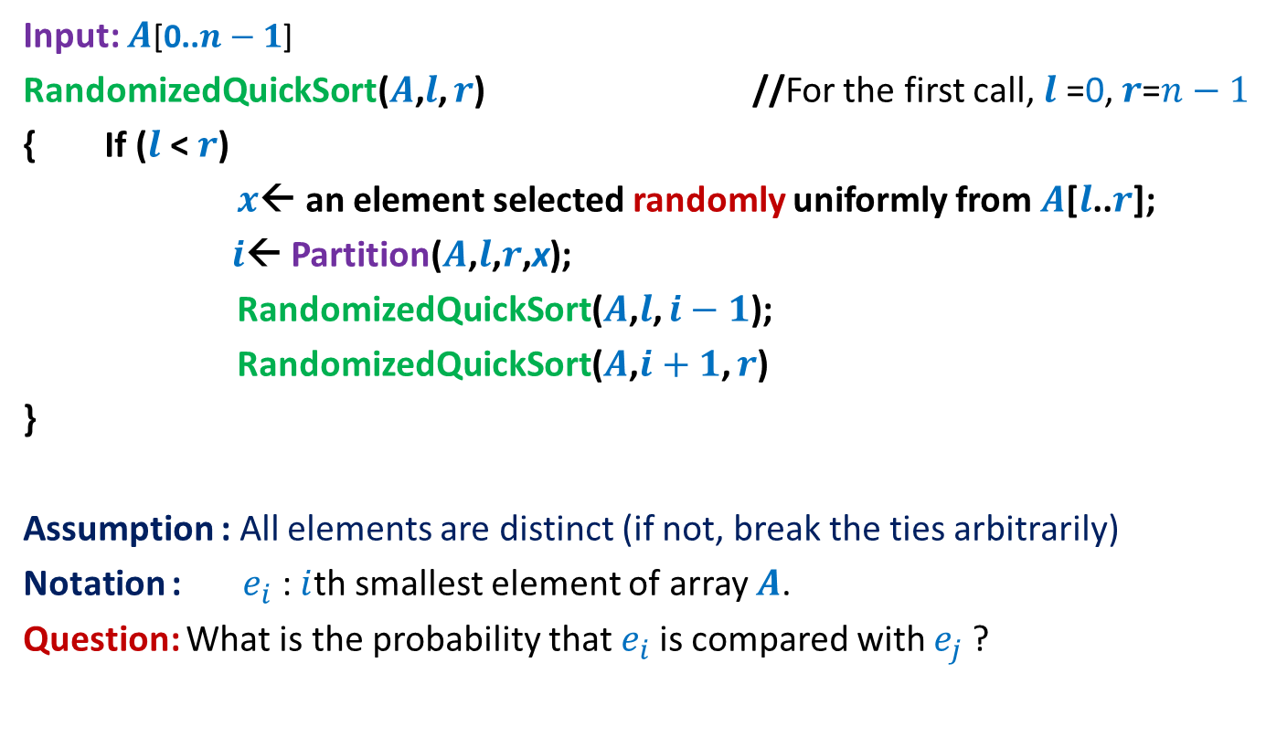
Randomized Quick Sort
Input: $A$[0..$n−1$]
RandomizedQuickSort($A$,$l$, $r$) //For the first call, $l$ =0, $r$=$n−1$
{ If ($l$ < $r$)
$x$← an element selected randomly uniformly from $A$[$l$..$r$];
$i$← Partition($A$,$l$,$r$,x);
RandomizedQuickSort($A$,$l$, $i−1$);
RandomizedQuickSort($A$,$i+1$, $r$)
}
Assumption : All elements are distinct (if not, break the ties arbitrarily)
Notation : $e_{i}$ : $i$th smallest element of array $A$.
Question: What is the probability that $e_{i}$is compared with $e_{j}$?
Recall that the execution of RandomizedQuickSort is totally immune to the permutation of $A$.

Slide 30
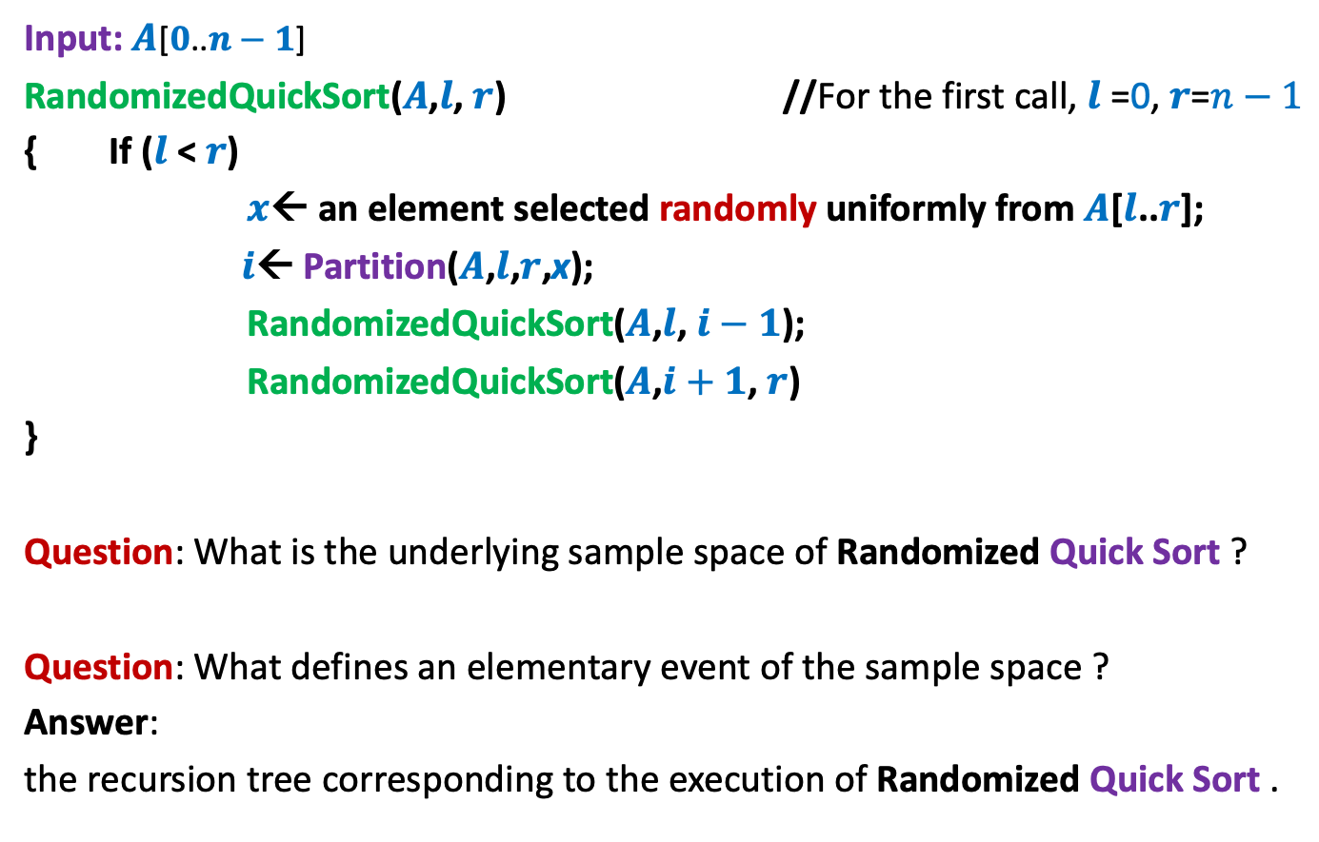
Randomized Quick Sort
Input: $A$[$0$..$n−1$]
RandomizedQuickSort($A$,$l$, $r$) //For the first call, $l$ =0, $r$=$n−1$
{ If ($l$ < $r$)
$x$← an element selected randomly uniformly from $A$[$l$..$r$];
$i$← Partition($A$,$l$,$r$,x);
RandomizedQuickSort($A$,$l$, $i−1$);
RandomizedQuickSort($A$,$i+1$, $r$)
}
Question: What is the underlying sample space of Randomized Quick Sort ?
Question: What defines an elementary event of the sample space ?
Answer:
the recursion tree corresponding to the execution of Randomized Quick Sort .

Slide 31



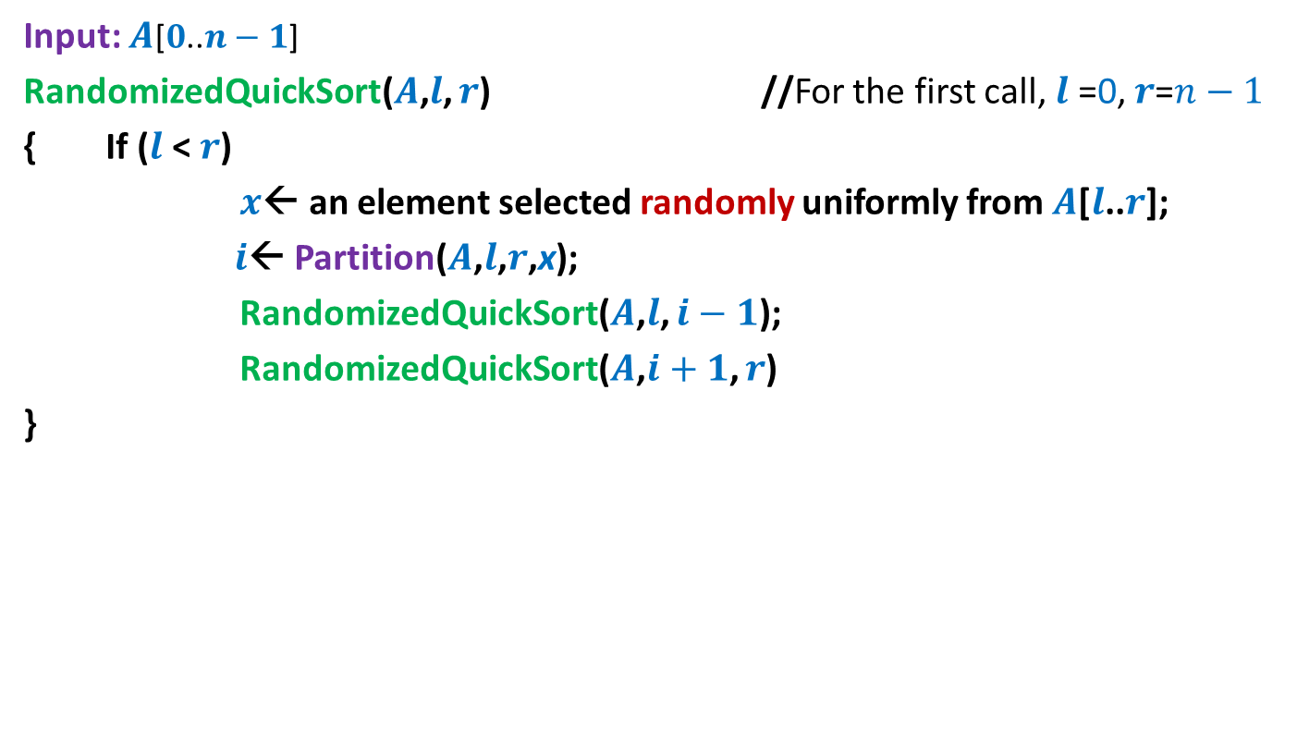

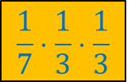




Randomized Quick Sort
Input: $A$[$0$..$n−1$]
RandomizedQuickSort($A$,$l$, $r$) //For the first call, $l$ =0, $r$=$n−1$
{ If ($l$ < $r$)
$x$← an element selected randomly uniformly from $A$[$l$..$r$];
$i$← Partition($A$,$l$,$r$,x);
RandomizedQuickSort($A$,$l$, $i−1$);
RandomizedQuickSort($A$,$i+1$, $r$)
}
$$n=7$$
$$\frac{1}{7}⋅\frac{1}{3}⋅\frac{1}{3}$$
$$e_{4}$$
$$e_{2}$$
$$e_{6}$$
$$e_{1}$$
$$e_{3}$$
$$e_{5}$$
$$e_{7}$$

Slide 32




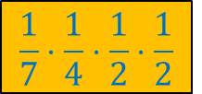




Randomized Quick Sort
Input: $A$[$0$..$n−1$]
RandomizedQuickSort($A$,$l$, $r$) //For the first call, $l$ =0, $r$=$n−1$
{ If ($l$ < $r$)
$x$← an element selected randomly uniformly from $A$[$l$..$r$];
$i$← Partition($A$,$l$,$r$,x);
RandomizedQuickSort($A$,$l$, $i−1$);
RandomizedQuickSort($A$,$i+1$, $r$)
}
$$n=7$$
$$e_{5}$$
$$\frac{1}{7}⋅\frac{1}{4}⋅\frac{1}{2}⋅\frac{1}{2}$$
$$e_{2}$$
$$e_{6}$$
$$e_{1}$$
$$e_{4}$$
$$e_{7}$$
$$e_{3}$$

Slide 33
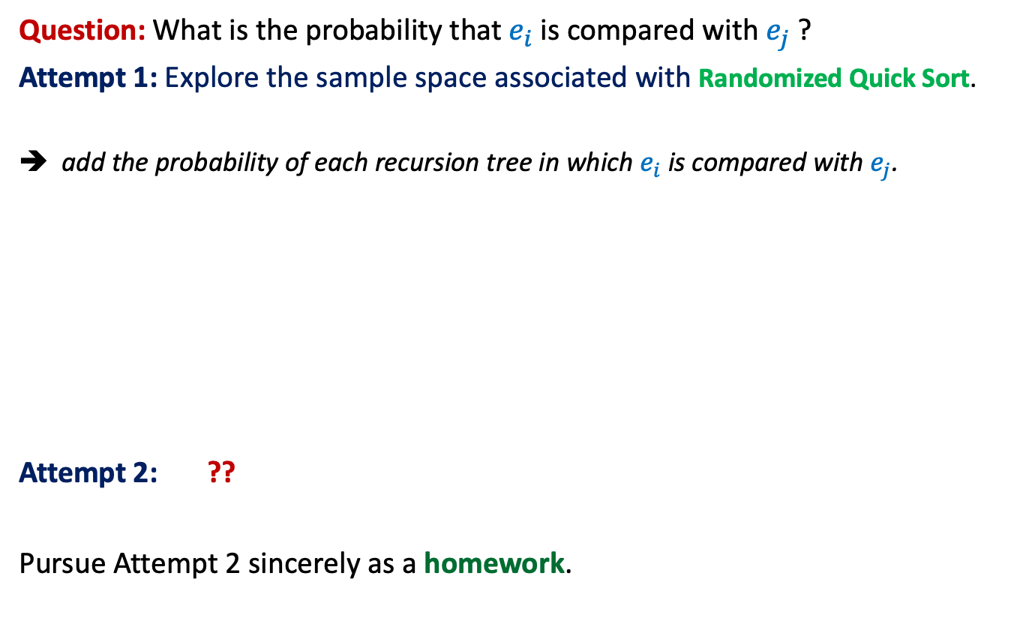
Randomized Quick Sort
Question: What is the probability that $e_{i}$is compared with $e_{j}$?
Attempt 1: Explore the sample space associated with Randomized Quick Sort.
➔ add the probability of each recursion tree in which $e_{i}$is compared with $e_{j}$.
Attempt 2: ??
Pursue Attempt 2 sincerely as a homework.
Not a feasible way to calculate the probability
View the execution of RandomizedQuickSort from perspective of $e_{i}$ and $e_{j}$

